Slide 1

Shield Illinois Data Updates
January 2024

Slide 2
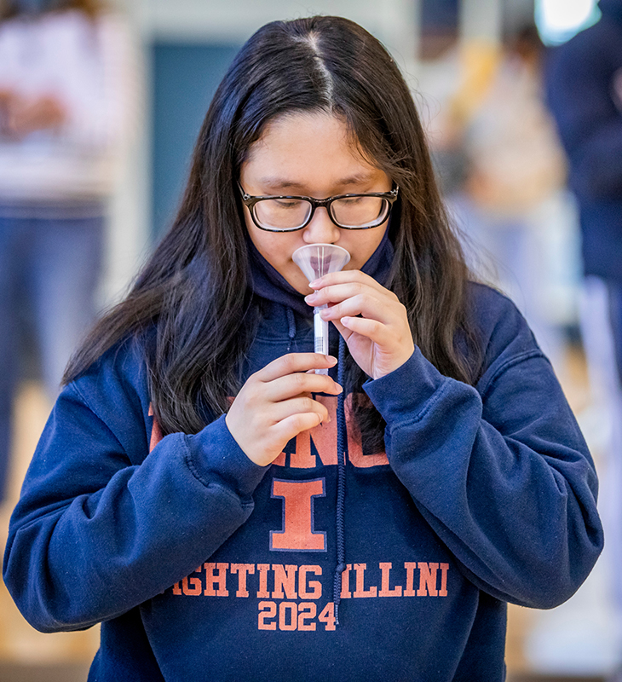
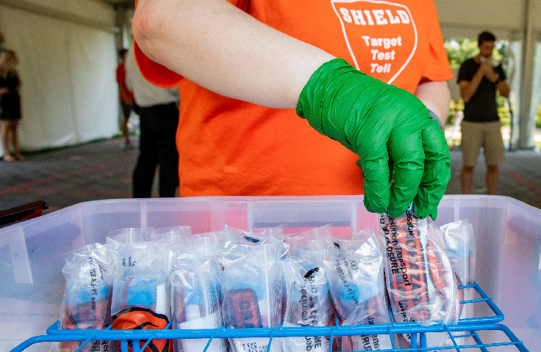
About Shield
SHIELD Illinois, (also referred to as “SHIELD”), is the University of Illinois System’s initiative to make the innovative saliva-based covid SHIELD COVID-19 test available to K-12 schools, colleges, universities, companies, and the public across the state of Illinois. SHIELD began testing in the Fall of 2020.
SHIELD’s clients are across the state of Illinois and include over 1,700 K-12 schools at their peak, as well as other higher education institutions, community colleges, and other organizations.
SHIELD progressed from processing less than 5,000 tests in the Fall of 2020, 85,500 tests in May 2021, and just under 900,000 tests in January 2022. SHIELD crossed the 6-million-test threshold in May 2022 and surpassed the 7-million-test threshold in February 2023.
SHIELD started with fewer than 10 direct employees in 2020 and grew to over 300 direct employees by early 2022. The most growth experienced at SHIELD was during the time of April 2021 to November 2021, when SHIELD grew from 70 direct employees to over 280 direct employees, increasing 300% within about 7 months.

Slide 3
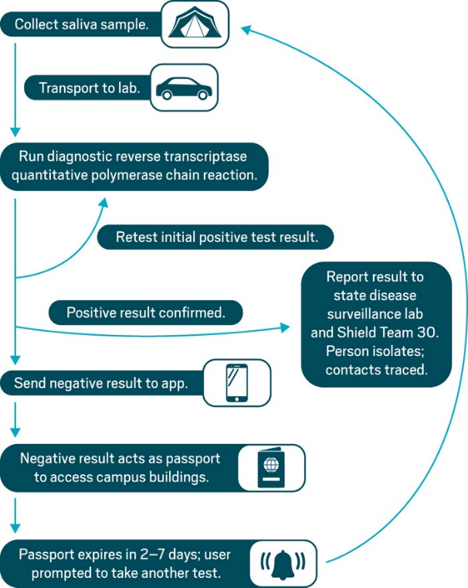
Collection and Transportation Process Flow
Shield has one depot located in Darien, IL. This depot receives shipments of samples that are collected in different sites across the IL state and re-routes them to multiple laboratories to be tested. This is done daily. The re-routing decisions are made by the depot.
The number of labs varies depending on different stages of Shield history. When the test volume was high, they had 5 (?) labs. Later they had 3 labs.
The re-routing decisions are (almost?) completely manual. It is done in an Excel spreadsheet. Shield provides this data.
A testing site collects samples. The test site drops the samples off at another location which could be a larger school. Shield’s vehicle picks up the samples at the location and transports the samples to the depot. The depot has samples transported to labs.
For larger schools, the Shield vehicle may go and pick samples up.
Some shipments can be directly delivered to the lab, not going through the depot.
Samples are collected, transported, and tested daily.

Slide 4
Manifest
Specimen
Saliva is collected from an individual
Collected at the testing center in a vial/test tube
Specimens are grouped together and transported in the form of manifests
Sample
Plate
Sample preparation occurs in the lab
Sample preparation involves heating saliva then mixing it with a combination of buffer and detergent
Technicians or pipetting robots transfer each sample into a 96-well plate
The well plate is fed into a PCR machine to conduct the test

Slide 5
Testing Centers Data
DePaul
Fatir Ihsan, Sina Ansari

Slide 6
General Questions about the data
Questions to Ask
Answered Questions
Questions for Fatir
Questions for Ali
What data does each file contain, its size, and the time span it covers?
What is the difference between a sample, plate, specimen, and manifest?
Manifest > plate > specimen > sample?
What is the difference between Specimen data in Specimen.csv and TV_Covid_Specimen.csv?
Daily, Weekly, and Monthly Trends for test collection overall, per agencies and labs
Number of testing sites (agencies) and labs
Zip codes of shield testing sites
Time from collection to results overall, per agencies and labs
We need the address of Labs and all test centers

Slide 7
Questions about EQUIPMENT.csv
Questions to Ask
Answered Questions
Questions for Fatir
Questions for Ali
What data does the data file contain and its size (rows and columns)?
How many labs are there? How much equipment per lab? How many unique equipment per lab?
The total number of equipment.
In column Equipment Types, we have many missing values, how to deal with them?

Slide 8
EQUIPMENT
Column Names
Barcode
ID
Name
Serial
Type
Lab_ID
386 obs. of 6 variables
Number of labs? 12 or 13?
- Lab ID 11 is missing
Missing values in equipment type and equipment serial number
- only two types shown, Gilson Pipetmax, Gilson Platemaster
299 of 386 rows empty in Equipment Type column, 77.46% data for Equipment Type missing

Slide 9
EQUIPMENT
Lab ID | No. of Equipment
1 | 58
2 | 17
3 | 29
4 | 36
5 | 65
6 | 31
7 | 26
8 | 45
9 | 18
10 | 11
11 | ??
12 | 22
13 | 28
What type of equipment used for each lab?
Multiple equipment used for each lab?​
Is a high equipment number attributed to size of lab?
4. What are the equipment used? The specific names of equipment.
5. Where is Lab ID 11?
6. Missing data for equipment.type and equipment.serial.number
7. Naming data in "Name" not consistent. For e.g. ‘metal rack’, ‘96 metal rack’, ‘Pipetmax’ ‘Gilson Pipetmax’

Slide 10
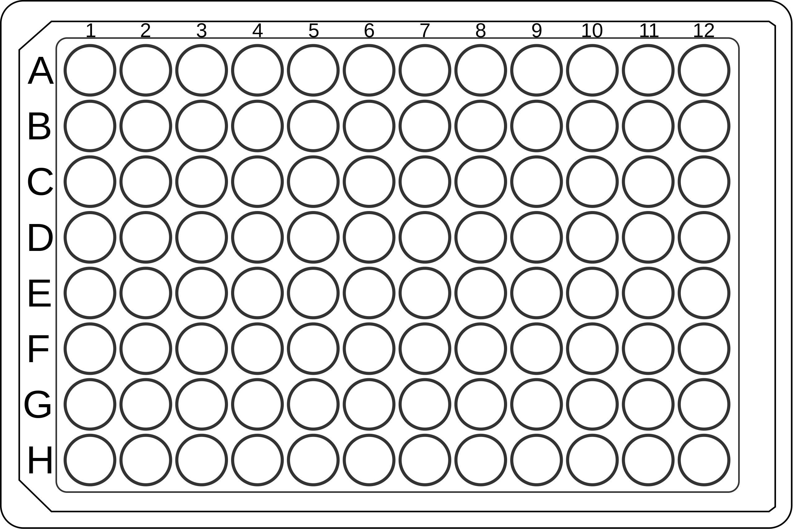
Questions about PLATE_96.csv & PLATE_96_SCAN.csv
Questions to Ask
Answered Questions
Questions for Fatir
Questions for Ali
What data does the data file contain, its size (rows and columns), and time span it covers?
How many labs/equipment/plates/techs are there? How much equipment per plate? How many techs per plate? How many plates does each tech process?
Relationship between Buffer Mix and Equipment, seems to one mix to many equipment
Time level analysis
# of plates per hour (overall and per lab)
# of plates per day of the week (overall and per lab)

Slide 11
Plate_96 and Plate_96_Scan
Questions to Ask
Answered Questions
Questions for Fatir
Questions for Ali
Plate 96
- 91140 observations, 7 variables
Plate_96_Scan
- 80802 observations, 5 variables
One plate has 96 wells, each well has one sample
Buffer solution stabalizes the viral RNA
Common variables: Equipment_ID, Plate_ID, Tech_ID
38.45% of data (Equipment_ID) missing from Plate_96_Scan
Time Span:
- Plate_96: 2021-02-04 to 2023-06-27
- Plate_96_Scan: 2021-02-04 to 2023-06-29
-> 4th February, 2021 to 29th June, 2023
Highest number of plates processed date: 01/20/22
Highest number of plates processed in week of 2022-01-09
Lab ID 11 missing from Plate_96 data as well
Equipment IDs not matching with the Equipment dataset
Number of equipment IDs is different in the two datasets
Multiple techs worked on the same plate,
multiple equipment are there for each plate?
There is a difference in the Plate and Plate Scan datasets. Are all the plates not scanned? Or is there missing data in the Scan dataset?
All labs have plates that are not present in the Plate_Scan dataset. Reason?
Plate_96 Column Names
BufferMix_ID
Equipment_ID
Lab_ID
Plate_Barcode
Plate_ID
Tech_ID
Timestamp
Plate_96_Scan Column Names
Equipment_ID
Plate_ID
Plate_Scan_ID
Tech_ID
Timestamp_Scan

Slide 12
Plate_96
Lab_ID | Num_Equipment | Num_Plates | Num_Techs | Num_BufferMix
1 | 6 | 14354 | 50 | 125
2 | 4 | 6053 | 30 | 140
3 | 5 | 4983 | 20 | 64
4 | 4 | 837 | 13 | 13
5 | 3 | 15729 | 48 | 186
6 | 2 | 7205 | 25 | 58
7 | 2 | 10275 | 29 | 138
8 | 3 | 14755 | 44 | 212
9 | 4 | 9342 | 15 | 103
10 | 3 | 1365 | 10 | 30
12 | 3 | 413 | 14 | 15
13 | 8 | 5829 | 11 | 75

Slide 13
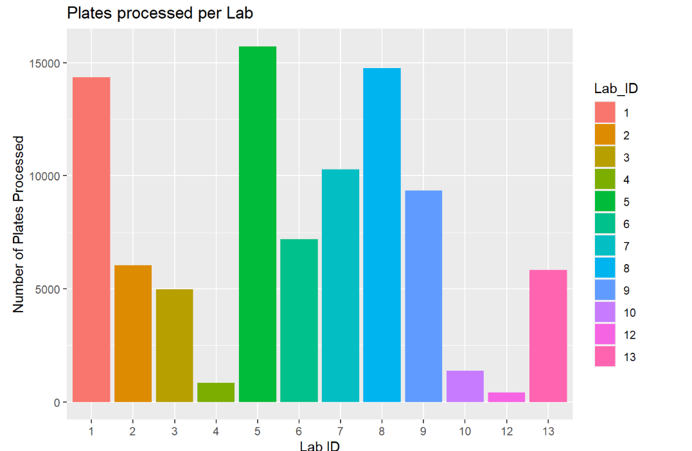
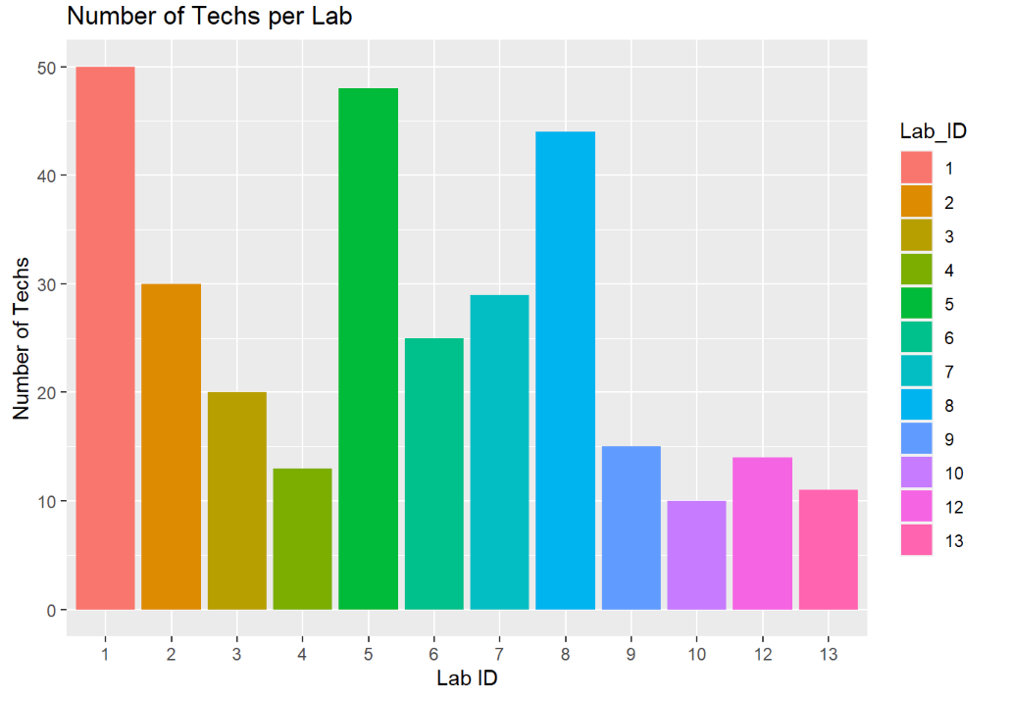
Plate_96 and Plate_96_Scan

Slide 14
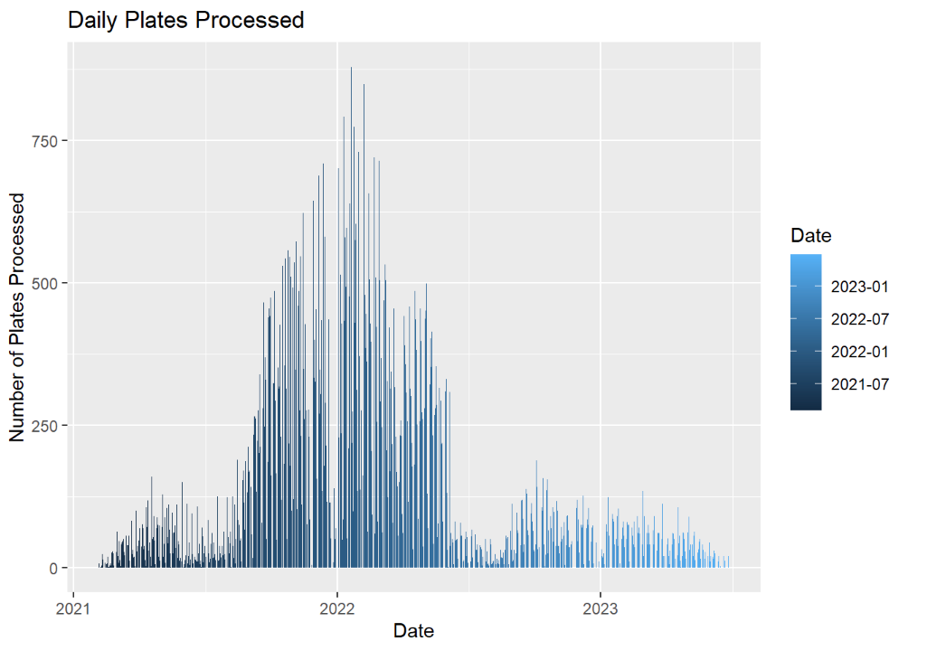
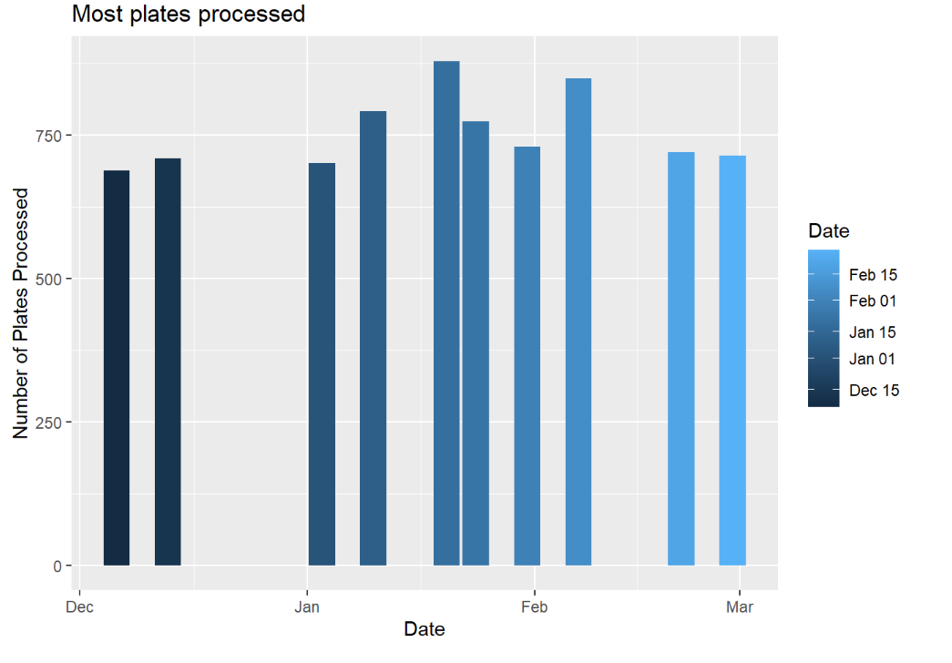
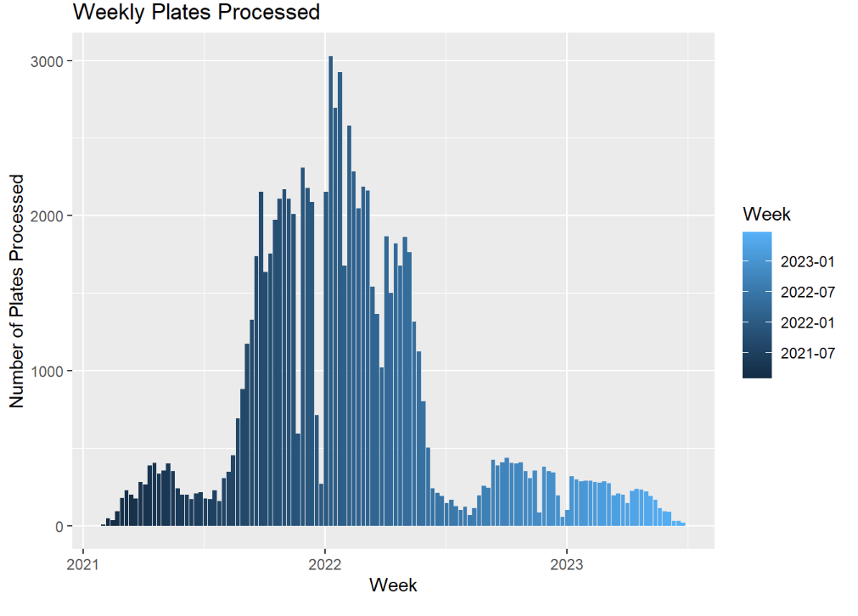
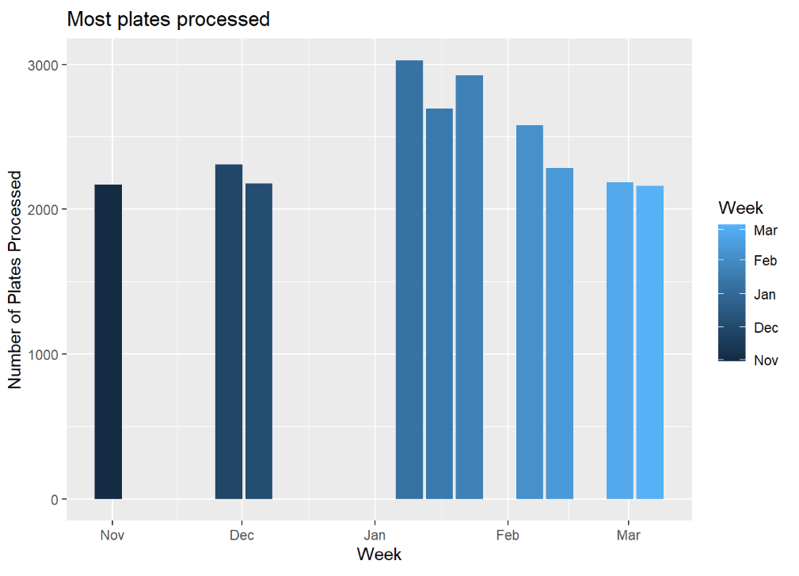
Plate_96 and Plate_96_Scan

Slide 15
Tech ID | No. of Plates Processed
245 | 4744
183 | 3756
86 | 2806
101 | 2423
274 | 2121
339 | 2107
85 | 2014
162 | 1893
282 | 1843
12 | 1726

Slide 16
Questions about SAMPLE.csv & SAMPLE_PLATE_96.csv
Questions to Ask
Answered Questions
Questions for Fatir
Questions for Ali
What data does the data file contain, its size (rows and columns), and time span it covers?
Daily, Weekly, and Monthly Trends for the sample overall, per agencies and labs
Time from sample collection to results overall, per agencies and labs

Slide 17
Sample and Sample_Plate
Sample
Column Names
Lab_ID
Sample_Barcode
Sample_ID
Tech_ID
Timestamp
Specimen_Count
Sample_Plate
Column Names
Plate_Scan_ID
Sample_ID
Plate_ID
Plate_Well
6598721 observations
6 variables
02/04/2021 - 06/29/2023
6876649 observations
4 variables

Slide 18
Sample and Sample_Plate
Sample_ID not unique in Sample_Plate dataset (for each ID we have multiple
Plate_ID is unique in Sample_Plate
-> How is Plate_ID unique? One plate should have 96 samples?
11 Labs
Oct 2022 onwards, data present for only Lab 5, 8 and 13
-> 5 and 8 have highest number of total samples. 13 is ranked 8th. Why 13? Maybe because of location?
Most samples in a day -> 01/19/22 -> 61712
Most samples in a week -> week of 01/23/22 -> 221240

Slide 19
Questions about SPECIMEN_REJECTED.csv & SPECIMEN.csv
What data does the data file contain, its size (rows and columns), and time span it covers?
Daily, Weekly, and Monthly Trends for the specimen overall, per agencies and labs
Time from specimen collection to results overall, per agencies and labs
How many specimens per sample is collected?
In SPECIMEN file, Lab ID 11 is missing but we have this ID in SPECIMEN_REJECTED file.

Slide 20
Questions about the SPECIMEN file (Alireza)
Some of the Tech IDs have been repeated for different Lab IDs. (example: Tec ID 1 for Lab IDs 1,2,5,7) WHY?
Based on my interpretation, the Specimen ID and SPECIMEN_ID (TEST_RESULT1) columns seem the same. Is it correct?
They seem to have different values
Based on my interpretation, the Tech ID and TECH_ID (TEST_RESULT1) columns seem the same. Is it correct?
They seem to have different values

Slide 21
SPECIMEN
Number of Columns
21
Number of Rows
6599595
Total Missing Values
62042
Count of Missing Values (SAMPLE_TEST_RESULT_ID)
15416
Count of Missing Values (SPECIMEN_ID_TEST_RESULT1)
15416
Count of Missing Values (TECH_ID_TEST_RESULT1)
15794
Count of Missing Values (TEST_RESULT_ID)
15416
Lab Barcode | Name | Counts | Lab ID | Lab Name | Lab User | Report Lab Name
54321 | ILLINOIS STATE UNIVERISTY COVID TESTING LAB | 1,007,270 | 1 | ISU | isu | ISU
216357 | Orchard Labs, Inc. | 47,080 | 4 | Neelyx | Orchard | Orchard
381450 |  | 493,022 | 6 | St. Mary's | decatur | Decatur
456406 | University of Illinois College of Medicine Rockford | 437,179 | 2 | Rockford | rockford | Rockford
623922 | Shield Illinois Covid Testing Lab | 1,199,108 | 5 | Springfield | springfield | SISpringfield
740528 | SHIELD Illinois Diagnostic Laboratory at UIC | 1,053,441 | 8 | SHIELDILUIC | Shield451 | Shield451
874140 |  | 818,054 | 7 | Loyola | loyola | Loyola
910488 | GIFT OF HOPE-INFECTIOUS DISEASE TEST | 255,527 | 3 | GOH | goh | GOH
485906 | T3 Madison | 770,779 | 9 | T3 Madison | madison | madison
736952 | Champaign Annex | 73,597 | 10 | Champaign Annex | annex | annex
 |  | Null | 11 |  |  | LAB7
629518 | Simple Labs | 26,704 | 12 | Simple Labs | simple | simple
374037 | T3 UIC | 417,834 | 13 | T3 UIC | uic | LAB7UIC

Slide 22
Specimen
6,599,595 observations, 21 variables (Allow Edit Results, Audit Racks, Lab Barcode, Lab Desc, Lab Id, Lab Name, Lab User, Report Lab Name, Specimen Id, Specimen_Barcode, Tech Id, TEST_RESULT, TS, TS LAB1, TS TEST RESULT1, Custormer ID, LAB ID LAB1, SAMPLE_TEST_RESULT_ID, SPECIMEN_ID TEST_RESULT1, TECH_ID TEST_RESULT1, TEST_RESULT_ID)
Lab.Id and Lab.Id.LAB1 columns are the same
Tech_Id and TECH_ID.TEST_RESULT1 columns are not the same (several discrepancies between these two columns)
3 different timestamps (TS, TS.LAB1, and TS.TEST_RESULT1)
The time difference between TS and TS.TEST_RESULT1 is varied between 1 minute to over 36 days
For TS.LAB1, not all the values are the same
TS..LAB1 has the most different time
No discrepanicies have been found between
SAMPLE_TEST_RESULT_ID and SPECIMEN_ID TEST_RESULT1
Values (TS.LAB1) | Frequency | Percentage (%)
2/8/2021 3:21:10 PM | 1938894 | 29.3789846
7/18/2021 9:47:14 PM | 1053441 | 15.9622068
1/25/2021 4:53:21 PM | 1007270 | 15.2626032
8/13/2021 12:00:00 AM | 844376 | 12.7943609
5/11/2021 4:07:28 PM | 818054 | 12.3955182
2/25/2021 6:44:11 PM | 493022 | 7.4704887
1/13/2022 10:27:21 AM | 417834 | 6.3312067

Slide 23
Specimen (Cont.)
All values for the Specimen_Id and Specimen_Barcode columns are unique
23.36% data missing for SAMPLE_TEST_RESULT_ID, SPECIMEN_ID..TEST_RESULT1., TEST_RESULT_ID
About 24% missing for TECH_ID..TEST_RESULT1.
From 2021-02-04 to 2023-06-29
Labs 5, 8 and 1 have the highest number of specimens
A mean of 276.5 minutes from specimen time stamp to result time stamp
What is the TS column?
There are three separate time stamps? Which is which?
Lab ID | Lab Name | Total Specimen
1 | ISU | 1007270
2 | Rockford | 437179
3 | GOH | 255527
4 | Neelyx | 47080
5 | Springfield | 1199108
6 | St. Mary’s | 493022
7 | Loyola | 818054
8 | SHIELDILUIC | 1053441
9 | T3 Madison | 770779
10 | Champaign Annex | 73597
12 | Simple | 26704
13 | T3 UIC | 417834
Test Result | Frequency | Percentage (%)
Blank | 15416 | 0.23359009
Negative | 6436216 | 97.52440869
Positive | 137975 | 2.09065859
Inconclusive | 6908 | 0.10467309
Invalid | 3080 | 0.04666953

Slide 24
Specimen
Lab ID | Lab Name | Lab Desc
1 | ISU | ILLINOIS STATE UNIVERISTY COVID TESTING LAB
2 | Rockford | University of Illinois College of Medicine Rockford
3 | GOH | GIFT OF HOPE-INFECTIOUS DISEASE TEST
4 | Neelyx | DO-NOT-SHOW Orchard Labs, Inc.
5 | Springfield | Shield Illinois Covid Testing Lab
6 | St. Mary's
7 | Loyola
8 | SHIELDILUIC | SHIELD Illinois Diagnostic Laboratory at UIC
9 | T3 Madison | T3 Madison
10 | Champaign Annex | Champaign Annex
12 | Simple | Simple Labs
13 | T3 UIC | T3 UIC

Slide 25
Specimen
Lab ID | Negative | Positive | Inconclusive | Invalid | Blank
1 | 981129 | 22800 | 1256 | 512 | 1573
2 | 413582 | 21191 | 747 | 301 | 1358
3 | 250523 | 3480 | 457 | 97 | 970
4 | 44531 | 105 | 24 | 7 | 2413
5 | 1167784 | 25831 | 1079 | 555 | 3859
6 | 475199 | 16056 | 652 | 238 | 877
7 | 803435 | 12515 | 808 | 227 | 1069
8 | 1033945 | 16510 | 711 | 253 | 2022
9 | 759096 | 10470 | 535 | 434 | 244
10 | 70297 | 2955 | 183 | 33 | 129
12 | 26246 | 154 | 11 | 28 | 265
13 | 410449 | 5908 | 445 | 395 | 637

Slide 26
Lab Name | Tech IDs | Total
Champaign Annex | 1, 224, 246, 263, 264, 265, 266, 322, 330, 337, 338 | 11
GOH | 1, 3, 7, 27, 28, 29, 30, 34, 61, 62, 78, 97, 103, 123, 151, 159, 166, 170, 199, 232, 235, 269, 273, 302, 306, 308, 351, 352 | 28
ISU | 1, 3, 4, 12, 13, 14, 15, 16, 18, 19, 20, 21, 22, 23, 24, 25, 26, 60, 97, 106, 107, 114, 115, 116, 119, 120, 124, 138, 158, 176, 177, 191, 200, 201, 212, 213, 216, 218, 219, 221, 223, 224, 225, 227, 228, 230, 240, 270, 276, 293, 298, 309, 311, 320, 321, 323, 325, 326, 327, 328, 329, 334, 347, 360 | 64
Loyola | 1, 97, 109, 110, 111, 112, 117, 121, 122, 129, 131, 132, 133, 134, 140, 143, 144, 145, 146, 147, 150, 152, 153, 155, 156, 198, 203, 208, 215, 242, 277, 278, 349, 367 | 34
Neelyx | 1, 3, 4, 5, 7, 8, 17, 31, 32, 33, 34, 74, 77 | 13
Rockford | 1, 3, 9, 36, 37, 38, 39, 40, 42, 43, 44, 45, 46, 47, 48, 63, 64, 66, 67, 68, 69, 88, 89, 96, 108, 135, 148, 162, 169, 173, 174, 180, 194, 236, 247, 268, 280, 285, 310, 319 | 40
SHIELDILUIC | 1, 3, 15, 27, 28, 37, 97, 103, 117, 121, 133, 151, 162, 163, 164, 166, 170, 178, 183, 192, 196, 199, 204, 233, 267, 269, 273, 274, 275, 287, 290, 291, 302, 332, 333, 335, 336, 339, 340, 351, 352, 354, 358, 389, 390, 391, 392, 394, 395, 396, 399, 400, 401, 405 | 54
Simple | 1, 117, 248, 252, 253, 255, 256, 257, 350, 356, 357, 362, 363, 364 | 14
Springfield | 1, 3, 6, 35, 49, 50, 51, 52, 53, 54, 55, 56, 57, 58, 59, 70, 71, 76, 86, 91, 92, 97, 98, 100, 101, 104, 105, 139, 154, 157, 160, 179, 206, 272, 279, 281, 282, 283, 305, 370, 371, 372, 373, 374, 375, 382, 383, 384, 385, 386, 387, 388, 397, 398, 403, 404, 406, 407, 408, 409, 410 | 61
St. Mary's | 3, 70, 71, 72, 73, 83, 84, 85, 86, 90, 91, 92, 93, 95, 97, 98, 210, 211, 214, 226, 231, 234, 237, 239, 246, 271, 370, 371 | 28
T3 Madison | 1, 3, 13, 171, 184, 185, 186, 187, 188, 189, 190, 193, 202, 241, 245, 292 | 16
T3 UIC | 1, 3, 186, 306, 308, 313, 314, 315, 318, 341, 343, 349, 378, 379, 405 | 15

Slide 27
Specimen_Rejected
112,012 observations, 16 variables (ALLOW_EDIT_RESULTs.LAB, AUDIT_RACKS.LAB, Customer.Id.Lab, Lab.Id.Lab, LAB_BARCODE.LAB, LAB_DESC.LAB, LAB_NAME.LAB, LAB_USER.LAB, Reason, REPORT_LAB_NAME.LAB, Specimen.Barcode.Specimen.Rejected, Status, Ts.Lab, Ts.Specimen.Rejected, LAB_ID.SPECIMEN_REJECTED, TECH_ID.SPECIMEN_REJECTED)
The name of Lab ID 11 is Depot (DEPOT-LAB Depot)
Order cancelled -> most common reason for specimen rejection, count of 28736
No discrepancies have been found between Lab.Id.Lab and LAB_ID.SPECIMEN_REJECTED1 columns
A mean of 245 days in difference between Lab.TS and TS.Rejected
Is the data wrong? Because the system cannot be this delayed

Slide 28
SPECIMEN_REJECTED
Number of Columns
16
Number of Rows
112012
Total Missing Values
201154
Count of Missing Values (ALLOW_EDIT_RESULTS (LAB))
28736
Count of Missing Values (AUDIT_RACKS (LAB))
28736
Count of Missing Values (Customer Id (Lab))
28736
Count of Missing Values (Lab Id (Lab))
28736
Count of LAB_BARCODE (LAB)
28736
Count of LAB_ID (SPECIMEN_REJECTED)
28737
Count of TECH_ID (SPECIMEN_REJECTED)
28737

Slide 29
SPECIMEN_REJECTED (Cont.)
Reason | Lab ID = 1 | Lab ID = 4 | Lab ID = 6 | Lab ID = 2 | Lab ID = 5 | Lab ID = 7 | Lab ID = 8 | Lab ID = 3 | Lab ID = 9 | Lab ID = 10 | Lab ID = 11 | Lab ID = 12 | Lab ID = 13 | SUM
Aged too long | 39 |  | 20 |  | 3 | 265 | 88 | 1 |  | 4 | 145 |  |  | 565
Collection Site Error |  |  |  |  |  | 1 |  |  |  |  |  |  |  | 1
Contamination - Blood | 333 | 7 | 1 | 436 | 85 | 5 | 32 |  | 3 | 19 | 11 |  | 1 | 933
Contamination - Food particles | 2,525 | 9 | 18 | 88 | 826 | 402 | 185 | 30 | 10 | 76 | 21764 | 22 | 49 | 26004
Contamination - Mucus | 1,883 | 62 | 4 | 100 | 277 | 268 | 733 | 4 | 28 | 93 | 10897 | 4 | 45 | 14398
Defective Container | 403 | 39 | 30 |  | 46 | 94 | 4 | 46 | 2 | 2 | 4 | 3 |  | 673
Discolored | 668 | 50 | 15 | 1,466 | 173 | 8,152 | 187 | 12 | 14 | 2 | 14049 | 38 | 45 | 24871
Lab unable to process | 1,256 |  | 103 | 88 | 82 | 23 | 1,035 | 3 | 4 | 21 | 173 | 9 | 69 | 2866
Leaking / Leaked | 260 | 19 | 105 | 1 | 276 | 142 | 7 | 1,020 | 18 | 11 | 68 | 2 | 9 | 1938
Missing DOB | 1,179 | 56 | 810 | 319 | 723 | 1,379 | 318 | 203 |  | 20 | 744 | 23 | 4 | 5778
Multiple Label(s) on Vial | 30 |  | 346 | 149 | 81 | 207 | 175 | 69 | 3 |  | 41 | 6 | 1 | 1108
No Order for Specimen | 1,401 | 162 | 755 | 541 | 1,565 | 2,018 | 1,276 | 521 | 1085 | 80 | 50 | 12 | 320 | 9786
No Specimen Received | 1,018 | 42 | 80 | 843 | 519 | 346 | 1,065 | 597 | 194 | 7 | 155 |  | 9 | 4875
Other Contamination | 425 | 6 | 74 | 271 | 759 | 1,821 | 772 | 1 | 6 | 179 | 15 | 1 | 431 | 4761
Patient Mislabeled | 119 | 264 | 117 | 95 | 133 | 1,700 | 4 | 106 | 2 |  | 4 | 37 |  | 2581
Quantity Out of Spec | 4,684 | 165 | 3,434 | 333 | 6,966 | 5,885 | 1,080 | 525 | 1278 | 150 | 2804 | 71 | 314 | 27689
Rejected by Collection Site |  |  |  |  | 4 |  |  | 42 |  |  |  |  | 60 | 106
Rejection Patient Mislabeled |  |  |  | 1 |  |  |  |  |  |  |  |  |  | 1
Temp out of spec |  |  |  | 4 | 402 |  | 13 |  |  |  | 6358 |  |  | 6777
Viscous | 782 | 14 | 221 | 273 | 2,384 | 2,170 | 123 | 269 | 29 | 31 | 7748 | 64 | 311 | 14419
Wrong Date of Birth | 274 |  | 2,851 | 1,115 | 5,810 | 4,316 | 5,220 | 549 |  | 201 | 13 | 172 | 19 | 20540

Slide 30
Questions about T_COVID_SPCMN.csv
What data does the data file contain, its size (rows and columns), and time span it covers?
Daily, Weekly, and Monthly Trends for specimen collection overall, per agencies and labs
Time from specimen collection to results overall, per agencies and labs
In this dataset we have a column for "performing facility zip" (Ask from Dr. Ansari)

Slide 31
T_COVID_SPCMN
2,907,747 observations and 88 variables
Total number of missing values 15,405,829
39794 number of manifest IDs
Mean time from collection to result = 19.22 hours
2,906,850 unique specimen --> from specimen barcode

Slide 32
T_COVID_SPCMN
LIMS | "Laboratory Information Management System". LIMS are computer-based information systems designed to manage a variety of laboratory operations, most notably sample management, data entry, data tracking, and the storage and retrieval of data
Date Depot Received | The date and time that information has been received by the warehouse (Depot)
Date EDW load | Specific date and time when data is loaded into an Enterprise Data Warehouse (EDW)
Number of Columns
88
Number of Rows
2907747
Total Missing Values
15405829
Count of Missing Values (NAI.CLIENT.ID..LIMS)
2907747
Count of Missing Values (NAI.HOME.KIT..LIMS)
1696701
Count of Missing Values (NAI.ORDERING.PROVIDER.ZIP)
232739
Count of Missing Values (NAI.PATIENT.BIRTH.YEAR..EMR)
232673
Count of Missing Values (NAI.PATIENT.ZIP)
40
Count of Missing Values (NAI.PERFORMING.FACILITY.ZIP)
235094
Count of Missing Values (NAI.TEST_ORDER..LIMS)
485635
Count of Missing Values (NAI.UNOBSERVED..LIMS)
1696706
Count of Missing Values (Patient.Age)
233157
Count of Missing Values (PATIENT.BIRTH.YEAR)
232674
Count of Missing Values (PATIENT.ID)
232651
Count of Missing Values (SPECIMEN.CODE)
232740
Count of Missing Values (NAI.ACCESSION.ID)
232740
Count of Missing Values (NAI.CUSTOMER.ID..LIMS)
485635
Count of Missing Values (NAI.LAG...COLLECTED.TO.RESULT)
43410
Count of Missing Values (NAI.LAG...RECEIVED.TO.RESULT)
77337
Count of Missing Values (LAG...Collected.to.Received)
2720313
Count of Missing Values (LAG...Collected.to.Sent)
233520
Count of Missing Values (LAG...Sent.to.Received)
2720314
Count of Missing Values (LAG...Sent.to.Result)
241352
Count of Missing Values (PATIENT.ID.Count)
232651

Slide 33
T_COVID_SPCMN (Cont.)
NAI.LAG...COLLECTED.TO.RESULT.RANGE | Count
Blank | 11,432
0-24 | 2,050,851
24-36 | 733,774
Over 36 | 111,690
NAI.LAB.STATUS | Count
Cancelled | 9,041
Closed | 198,538
Corrected | 309
Final | 2,699,603
Sent | 256
NAI.PATIENT.RACE | Count
Blank | 280,907
American Indian or Alaska Native0 | 56,699
Asian | 212,134
Asked but Unknown | 19,204
Blacked or African American | 307,956
Declined | 46,950
Native Hawaiian or Other Pacific Islander | 10,388
Other Race | 77,985
Unknown | 362,207
While | 1,533,317
X.NAI.LAG...RECIEVED.TO.RESULT.RANGE | Count
Blank | 43,093
0-24 | 2,665,114
24-36 | 177,924
Over 36 | 21,616
NAI.PATIENT.GENDER | Count
Blank | 251,436
0 | 8
1 | 16
f | 1,017
F | 1,345,075
m | 334
M | 1,301,502
N | 3
O | 1
U | 8,301
X | 54
X.NAI.PATIENT.TYPE..EMR. | Count
Blank | 252,966
Community | 194,929
Employee | 618,919
Student | 1,840,933

Slide 34
T_COVID_SPCMN (Cont.)
NAI.RESULT.EMR | Count
In Process | 9,136
Inconclusive | 2,577
Invalid | 2,015
Negative | 2,794,042
Positive | 51,256
Rejected | 48,720
PATIENT.AGE.GROUP | Count
0, 1, 2 and 2 more | 866
11-13 | 536,689
14-18 | 469,317
19 | 50,504
20-29 | 381,765
30-39 | 207,678
40-49 | 175,524
5-10 | 604,815
50-59 | 146,357
60-69 | 84,196
70-79 | 14,610
80-89 | 2,019
90-99 | 241
Other | 233,165
Collected_CP_Timeline | Count
TRUE | 43,667
FALSE | 2,864,079

Slide 35
T_COVID_SPCMN (Cont.)
The Lag Range of Collected to Results
Blank | 0-24 hrs | 24-36 hrs | Over 36 hrs
11432 | 2050851 | 733774 | 111690
The Lag Range of Received to Results
Blank | 0-24 hrs | 24-36 hrs | Over 36 hrs
43093 | 2665114 | 177924 | 21616
Lab Status
Cancelled | Closed | Corrected | Final | Sent
9041 | 198538 | 309 | 2699603 | 256
The differences among the different levels of Lab Status

Slide 36
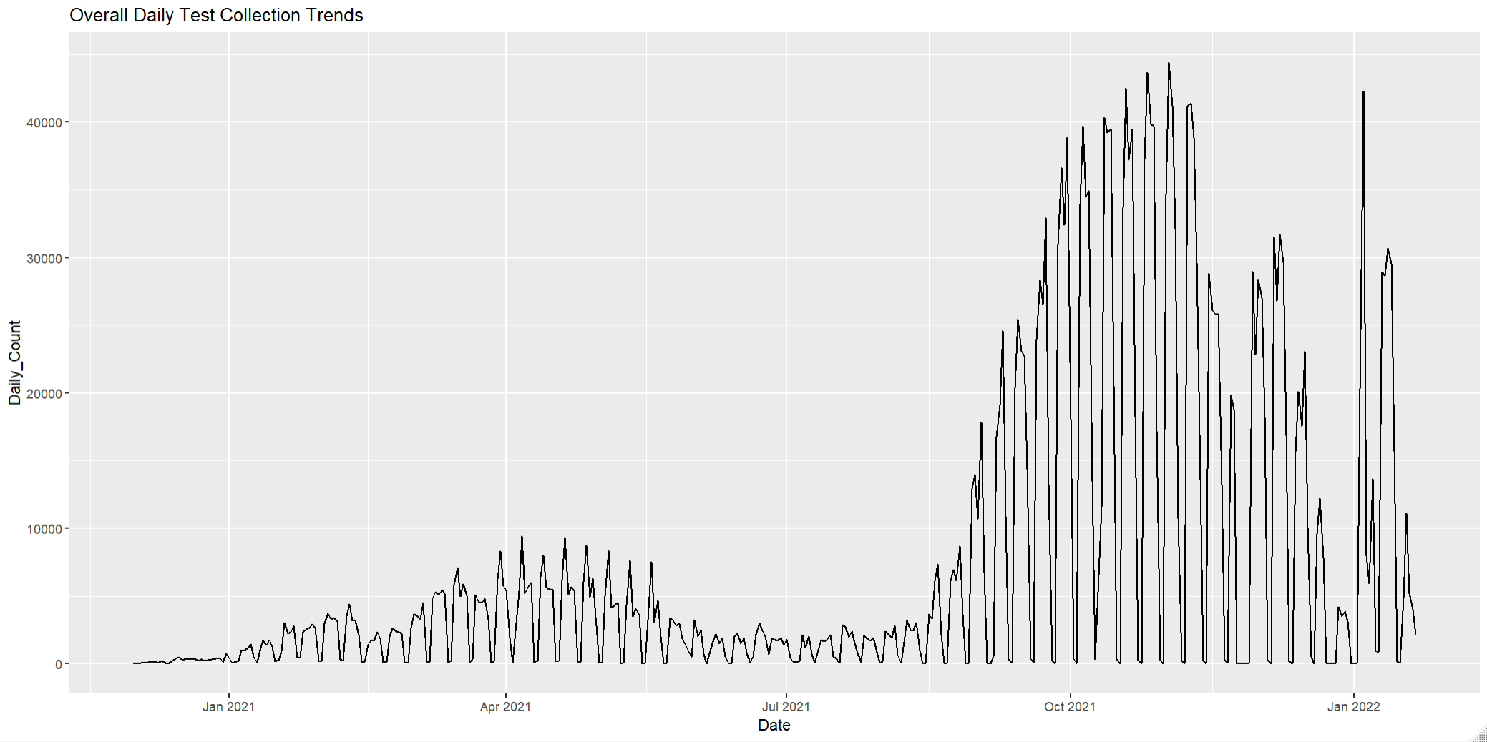

Slide 37
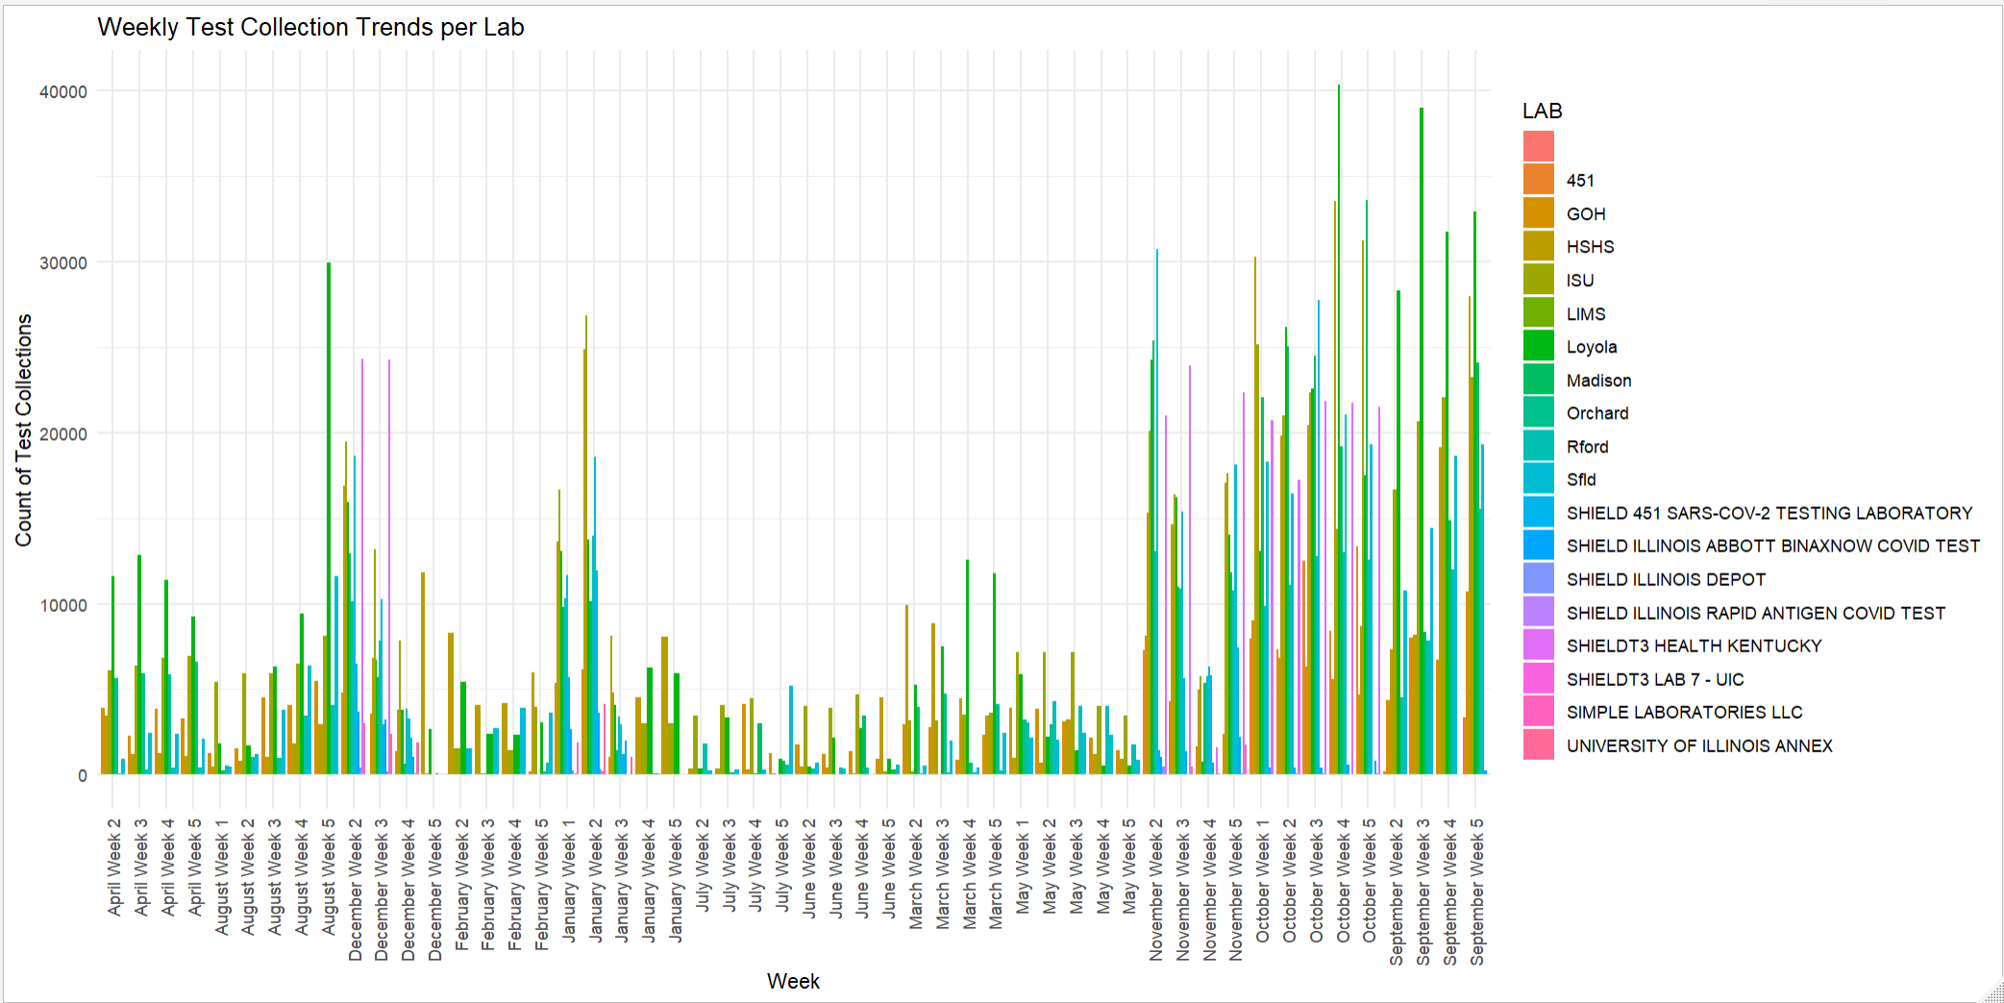

Slide 38
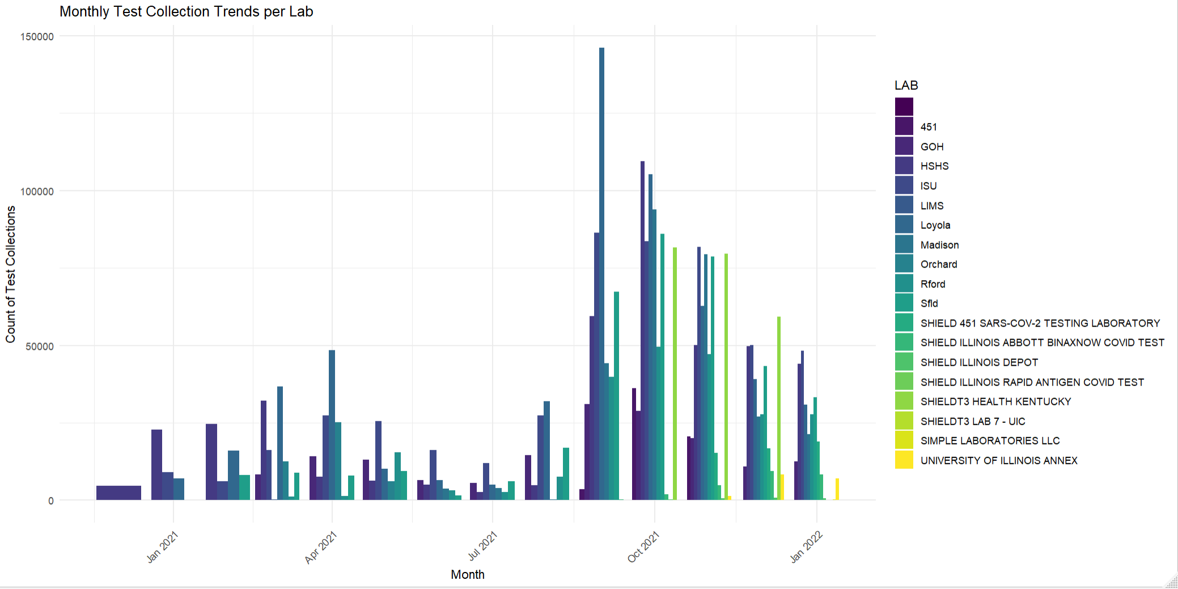

Slide 39
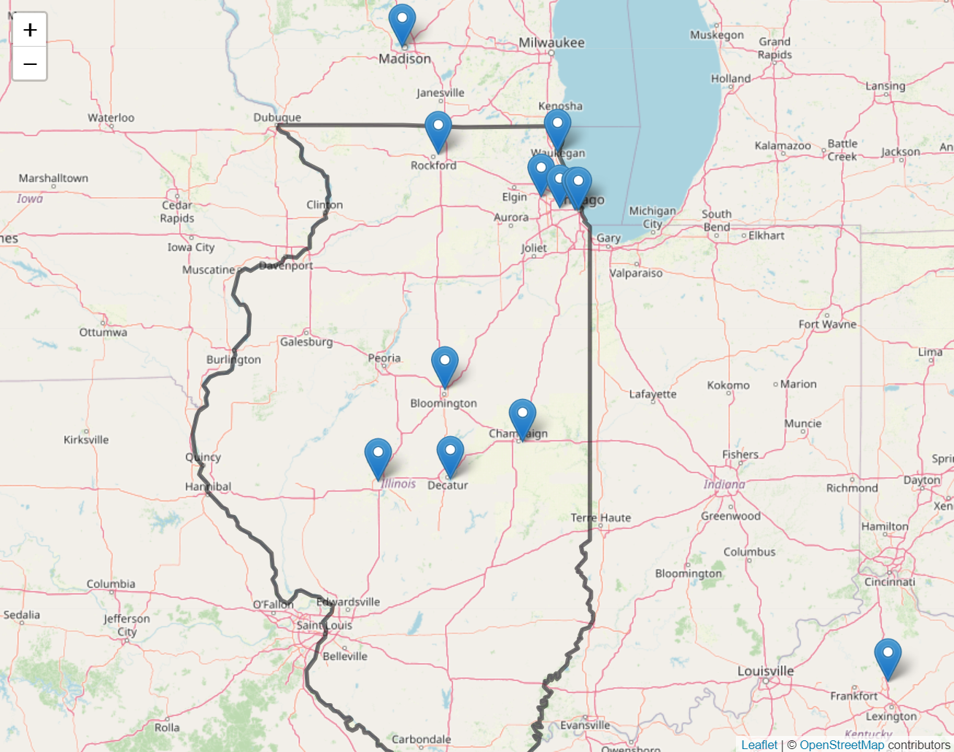
Lab Locations

Slide 40
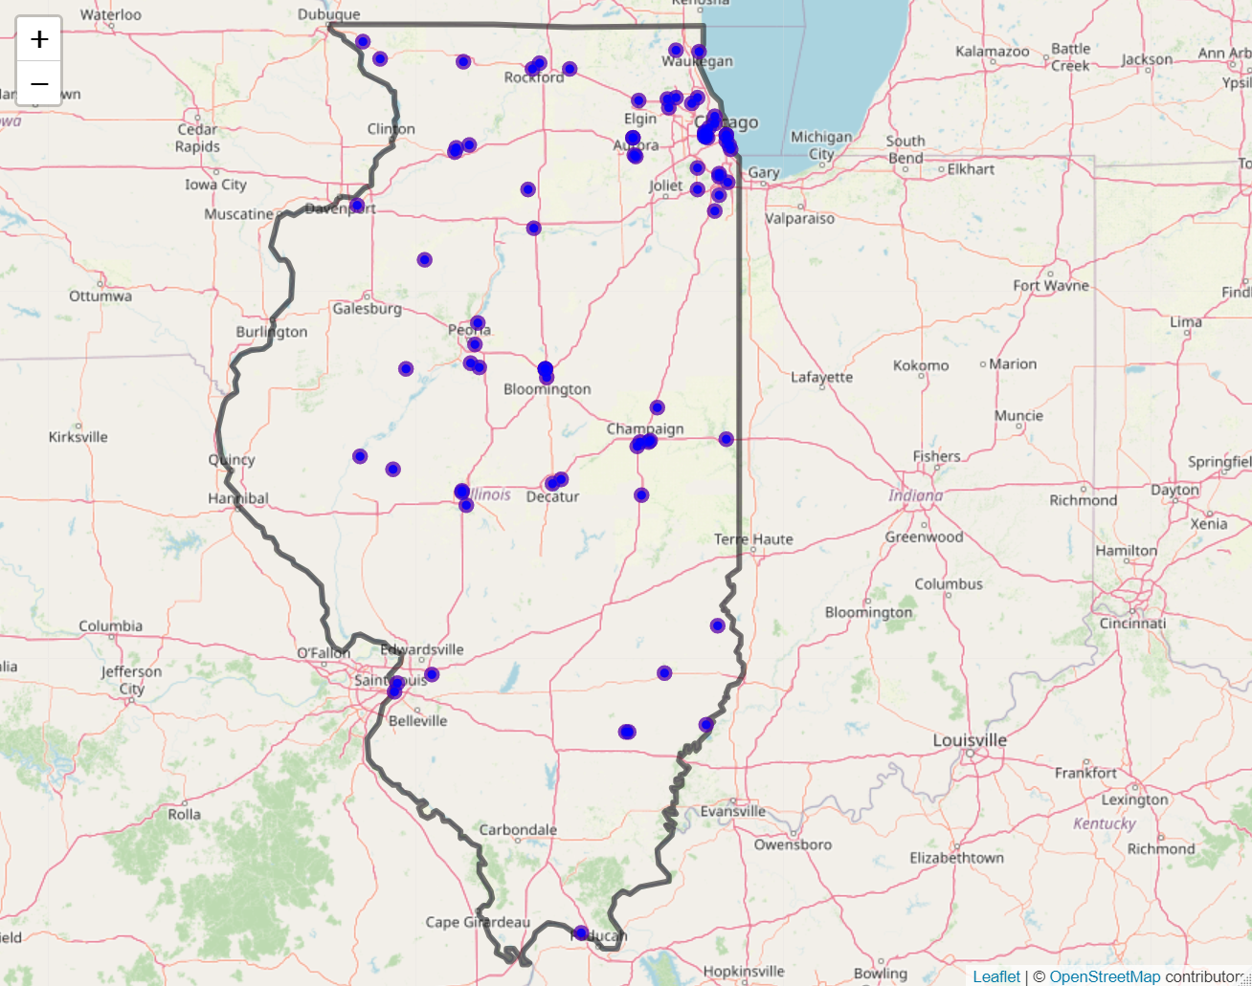
Community Testing Locations

Slide 41
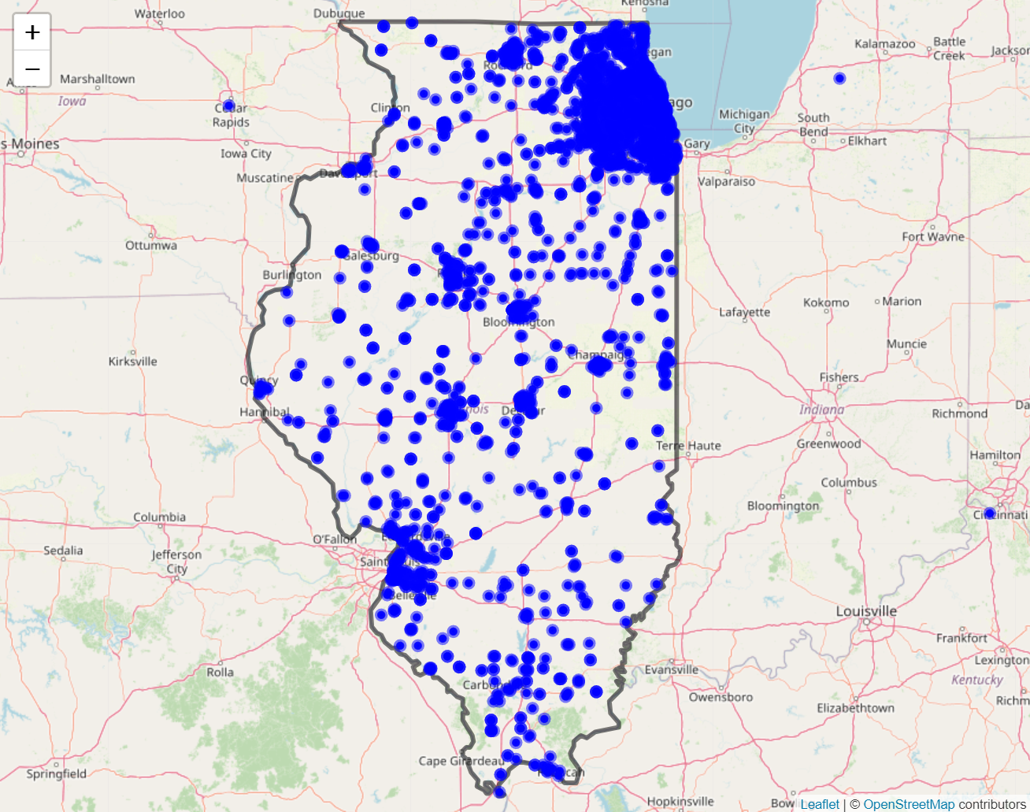
Collection Locations

Slide 42
Transportation Data
NIU
Ziteng Wang

Slide 43
Questions about the data

Slide 44
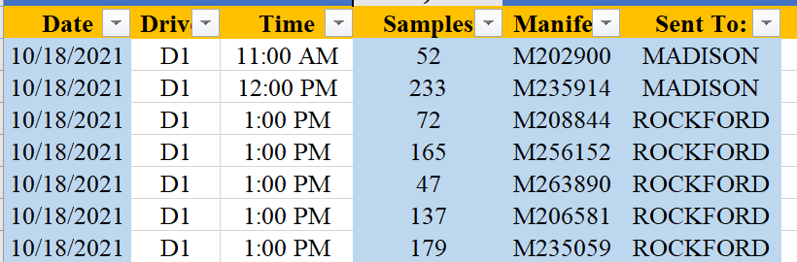

Slide 45

Data Requests and Questions from Shield

Slide 46
Data Requests (including missing data)

Slide 47
Questions from Shield
What is typical equipment used in a lab?
Why there is no lab 11?

